Slide 1
GENERAL DEVELOPMENTS IN CLASS ACTION LAW
2018
Judge YVONNE Gonzalez rogers
Angel garganta, VENABLE LLP
Shana scarlett, HAGENS BERMAN SOBOL SHAPIRO LLP
NORTHERN DISTRICT PRACTICE PROGRAM
2018 CIVIL LAW SYMPOSIUM: CLASS ACTIONS
SEPTEMBER 13, 2018

Slide 2
Recent Developments: Ascertainability
Ninth Circuit has rejected the requirement of a “administratively feasible” means of identifying absent class members. Briseno v. ConAgra Foods, Inc., 844 F.3d 1121 (9th Cir. 2017).
But the Third Circuit in Carrera v. Bayer Corp., 727 F.3d 300, 308 (3rd Cir. 2013) held that a plaintiff must also “demonstrate his purported method for ascertaining class members is reliable and administratively feasible.”
Most Circuits have followed the Ninth. See, e.g., In re Petrobras Sec., 862 F.3d 250, 265 (2d Cir. 2017) (expressly rejecting the heightened standard); Rikos v. Procter & Gamble Co., 799 F.3d 497, 525 (6th Cir. 2015) (same); Mullins v. Direct Dig., LLC, 795 F.3d 654, 657 (7th Cir. 2015) (same).

Slide 3
Recent Developments: Predominance
But have settlements become more difficult?
In re Hyundai and Kia Fuel Economy Litigation
What do litigants need to show to have a settlement class certified?
The panel decision has been depublished pending rehearing en banc

Slide 4
Recent developments: SETTLEMENTS
Supreme Court has granted cert in Frank v. Gaos., 869 F.3d 737 (9th Cir. 2017)
$8.5 million in cy pres with no funds to the class
Privacy violations by Google
One of the objections: if distribution to class members is infeasible, then class certification is improper

Slide 5
Online Advertising Revenue in the United States from 2000 to 2017

Slide 6
Consider the Appropriateness of Publication Notice

Slide 7
Notice in Damages Classes
Direct notice
Email to all possible class members
Phone numbers / text messaging – the way of the future?
Postcards – consider whether cost effective and necessary
Indirect notice
Online: Facebook / banner campaigns
Press Releases
Attorney interviews
Settlement Webpage
Get creative!
www.reversethecharge.com (Lithium Ion Batteries overcharge)

Slide 8
Design Your Notice Program
Seek bids from multiple vendors.
Negotiate down the proposals. The first price is not the last price.
Be aware of hourly charges for undefined projects.
Think about your long term goals:
Damages Classes: Converting notice to claims being made on the settlement fund

Slide 9
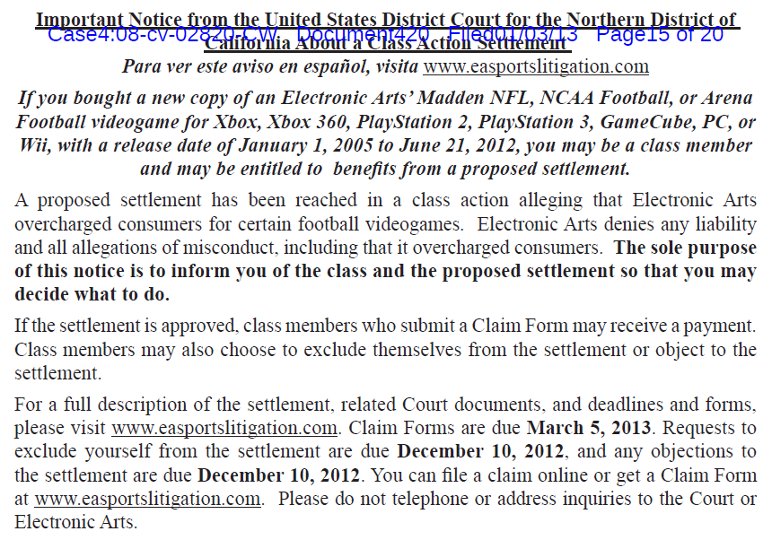
Consider Simpler Notice
This is constitutional.
So why do we send this?
Actual notice proposed by OC, approved, and sent in Kmart ADA Title III settlement.

Slide 10
Consider Graphics/Logos

Slide 11
Lithium Ion Battery Case – In Progress (all Indirect Purchaser Plaintiffs)
Current Claims Count = 921,821
Claims Period To Close on January 18, 2019
Averaging 10,000 claims per week
Comparison to Other IPP Antitrust Actions in CAND
D-RAM 278,368 (final)
LCD 249,541 (final)
OPTICAL DISC 348,388 (in progress)

Slide 12
Personal Experience as Class Member
"Schlesinger v. Ticketmaster Settlement Administrator" <TicketFeeLitigation@tgcginc.com> Date: September 19, 2017 at 9:12:37 AM PDT To: Subject: Reminder: Schlesinger v. Ticketmaster Settlement Reply-To: "Schlesinger v. Ticketmaster Settlement Administrator" <TicketFeeLitigation@tgcginc.com>
As a class member of the Schlesinger settlement, last year you were given discount codes and ticket vouchers to be used on Ticketmaster.
Any unused codes and vouchers can be found here. Note that your Live Nation login and password is the same as your Ticketmaster login and password.
Discount codes can be applied toward a future ticket purchase or UPS ticket delivery Redeem codes on Ticketmaster.com.
Ticket vouchers may potentially be redeemed for general admission tickets at select Live Nation events. While ticket voucher redemption is complete for 2017, you can sign up here to receive periodic notifications by email when eligible events are made available.
For more information regarding the settlement, visit www.ticketfeelitigation.com.
If you wish to UNSUBSCRIBE from future email messages from the Settlement Administrator with regard to this Settlement, please click on this link.

Slide 13
Tensions to Consider
Traditional Claims Administrators are reluctant to change approach without judicial encouragement
Judicial Oversight might need to expand
Review not just official notices but banner advertisements for clarity and effectiveness
Website review
Consider additional language options
Increase claims period, objections, and opt-out periods to allow social media to help
Privacy Concerns
Security Concerns
Lack of Much Precedent

Slide 14
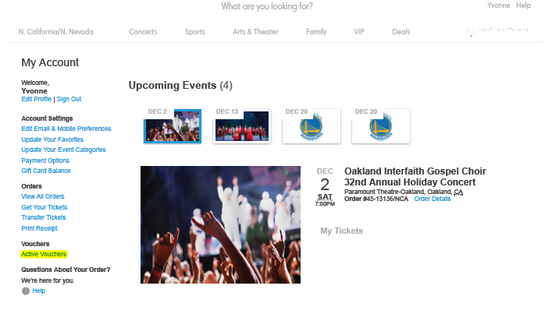
Personal Experience as Class Member
Accessing the log-in page does not notify users that they have any active vouchers.
Rather, the user must already know they have active vouchers to prompt them into clicking on the link.

Slide 15
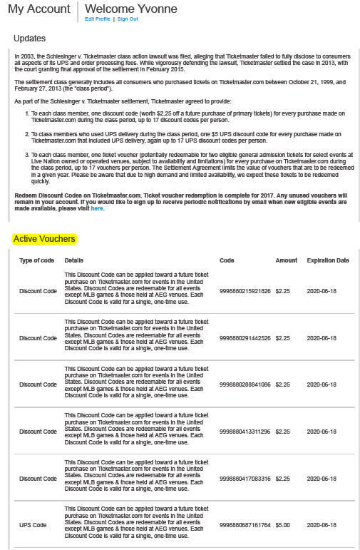
Personal Experience as Class Member
The settlement class generally includes all consumers who purchased tickets on Ticketmaster.com between October 21, 1999, and February 27, 2013 (the "class period").
As part of the Schlesinger v. Ticketmaster settlement, Ticketmaster agreed to provide:
To each class member, one discount code (worth $2.25 off a future purchase of primary tickets) for every purchase made on Ticketmaster.com during the class period, up to 17 discount codes per person.
2. To class members who used UPS delivery during the class period, one $5 UPS discount code for every purchase made on Ticketmaster.com that included UPS delivery, again up to 17 UPS discount codes per person.
3. To each class member, one ticket voucher (potentially redeemable for two eligible general admission tickets for select events at Live Nation owned or operated venues, subject to availability and limitations) for every purchase on Ticketmaster.com during the class period, up to 17 vouchers per person. The Settlement Agreement limits the value of vouchers that are to be redeemed in a given year. Please be aware that due to high demand and limited availability, we expect these tickets to be redeemed quickly.

Slide 16
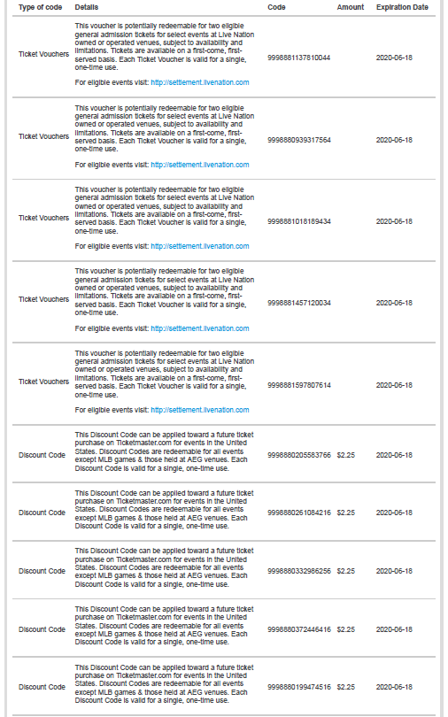
Personal Experience as Class Member cont’d
Ticket Vouchers: This voucher is potentially redeemable for two eligible general admission tickets for select events at Live Nation owned or operated venues, subject to availability and limitations. Tickets are available on a first-come, first-served [sic] basis. Each Ticket Voucher is valid for a single, one-time use.
For eligible events visit: http://settlement.livenation.com
Discount Code ($2.25): This Discount Code can be applied toward a future ticket purchase on Ticketmaster.com for events in the United States. Discount Codes are redeemable for all events except MLB games & those held at AEG venues. Each Discount Code is valid for a single, one-time use.

Slide 17
Electronic distribution may be cheaper and more effective

Slide 18
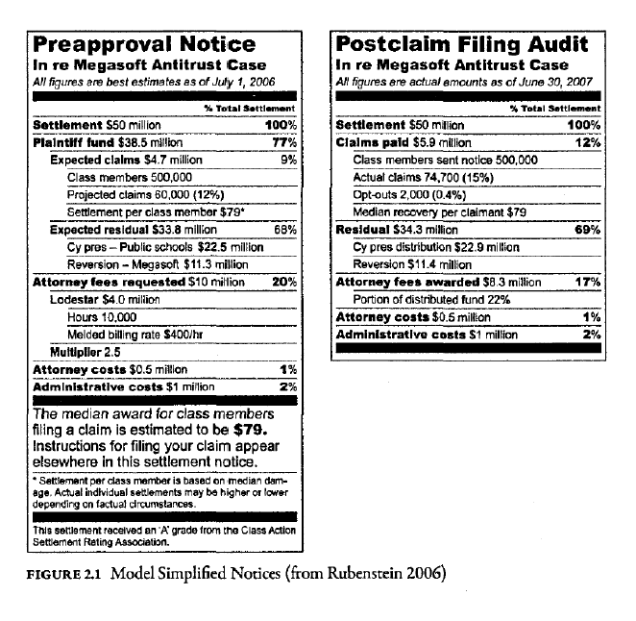
More reports to the court on the effectiveness of the campaigns.

Slide 19
Notice Aggregators
“We tell you about cash you can claim every week! Subscribe to our free newsletter today.”
https://topclassactions.com/lawsuit-settlements/open-lawsuit-settlements
“CLAIM YOUR CLASS ACTION SETTLEMENT MONEY TODAY 1. Find products you purchased. 2. Fill out the claim form. 3. Get your check in the mail.”
https://www.classactionrebates.com
“These 8 Class-Action Settlements Are Easier to Catch than a Leprechaun”
https://www.thepennyhoarder.com/deals/march-class-action-settlements-2018

Slide 20
Notice Aggregators
“No Proof Required Class Action Lawsuit Settlements – September 2018. In this post, we will list out all of the Best Class Action Lawsuit Settlements that require no proof of purchase, receipts, etc.”
http://www.hustlermoneyblog.com/no-proof-required-class-action-lawsuit-settlements
“Did you know fellow readers are constantly getting checks from no proof of purchase settlements recently? Get in on the free cash with class action settlements that don’t require any proof of purchase, and if you do have proof of purchase, you can get even more cash in most cases!”
https://yofreesamples.com/samples-without-surveys/class-action-cash-settlement-claims-without-proof-of-purchase

