Slide 1
Northern District of California Pretrial Release Rates and Outcomes
May 10, 2023 Federal Practice Panel
The Bail Decision: Fashioning Conditions to Avoid
Unnecessary Pretrial Detention

Slide 2
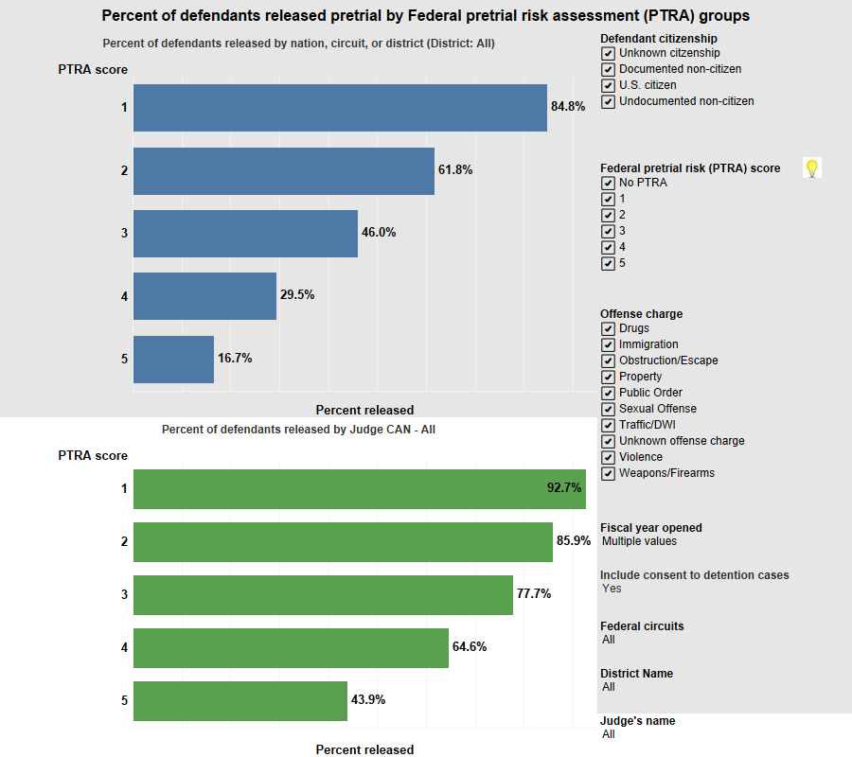
Release by PTRA - NDCA vs. Nation (FY 2019 – 2021)

Slide 3
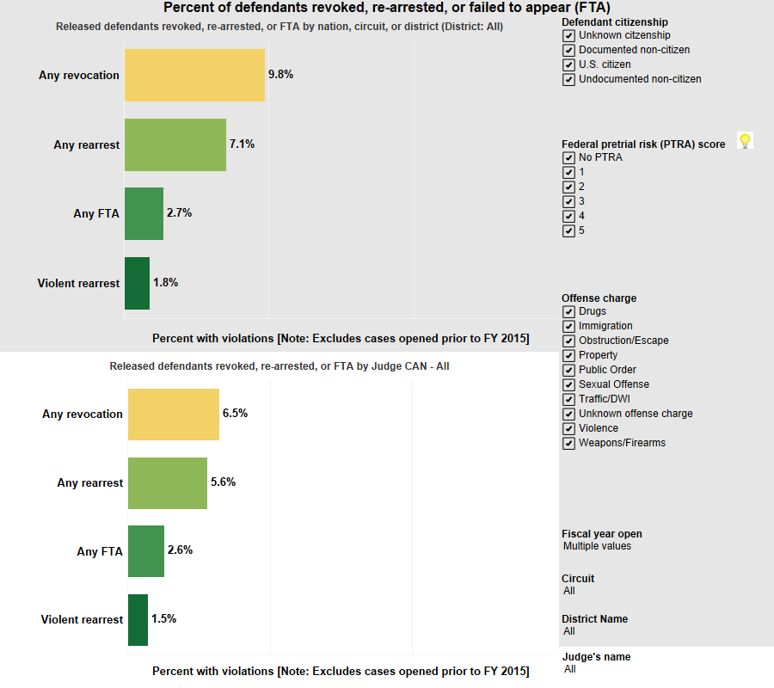
Outcomes - NDCA vs. Nation (FY 2019 – 2021)

Slide 4
PRETRIAL SERVICES BAIL RECOMMENDATIONS
DSS Report 1288 Pretrial Recommendations by PTRA (excludes undocumented defendants) for 12-month period ending December 31, 2022
Notes:
DSS report 1288 recommendations by PTRA (excludes undocumented defendants) 1/1/2022 t Ho 12/31/2022.
-What do these stats show us? It’s split down the middle (7 above and 7 below the national average.
A = WAE
B = CAE
C = ID
D = MT
E = CAC
F = AK
G = NV
H = AZ
I = WAW
J = HI
K = CAN
L = OR
M = CAS
N = Guam

Slide 5
Nationally, Higher Release Rates Produce Better Pretrial Outcomes (2022)
Notes:
DSS Report 1288 Pretrial Release Recommendations by PTRA (Officer Release Recommendations Compared to AUSA and Actual Release Rate for Intakes Activated 1/1/2022 to 12/31/2022) to identify top five highest release rate districts and bottom 5 release rate districts
DSS Report 1244 Pretrial Services Supervision Outcome Report for time period 1/1/2022 to 12/31/2022 for rearrest/FTA rates
Top Five Districts: AL-N (65%), AR-E (65.1%), Guam (70.6%), MS-N (68.7%), NH (72.8%): Average: 68.44%
Bottom Five Districts: IA-S (26.1%), IL-C (23.9%), NC-E (25.7%), TN-E (20.8%), WY (20.2%): Average: 23.34%
Rearrest/FTA
Top Five Districts: AL-N (2.4/1.9), AR-E (3.3/5.4), Guam (1.4/1.4), MS-N (.5/.5), NH (.9/3.1): 1.7/2.46
Bottom Five Districts: IA-S (.4/5.6), IL-C (5.9/.5), NC-E (.3/6.1), TN-E (0/2), WY (0/1.5): 1.32/3.14

Slide 6
PTS & AUSA Recommendations and Bail Decisions by District, Circuit, Nation (FY2019-2021)
Pretrial Services Dashboards: FY 2019 to FY 2021 (statistics include undocumented defendants)

