Slide 1
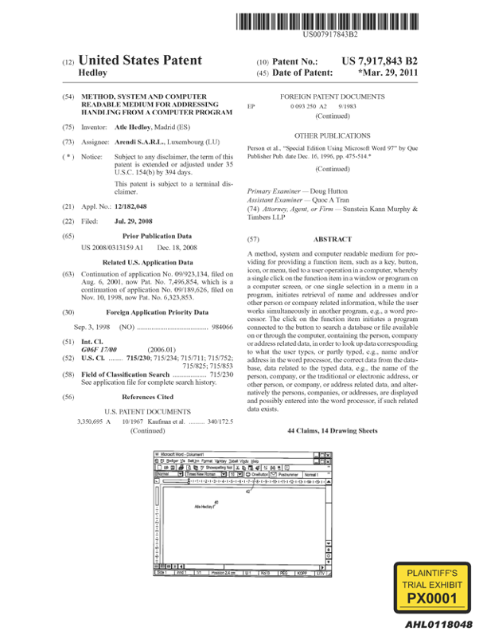
“First Computer Program”
23. At least one non-transitory computer readable medium encoded with instructions which, when loaded on a computer, establish processes for finding data related to the contents of a document using a first computer program running on a computer, the processes comprising:
displaying the document electronically using the first computer program;
while the document is being displayed, analyzing, in a computer process, first information from
the document to determine if the first information is at least one of a plurality of types of information that can be searched for in order to find second information related to the first information;
retrieving the first information;
providing an input device, configured by the first computer program, that allows a user to enter a user command to initiate an operation, the operation comprising (i) performing a search using at least part of the first information as a search term in order to find the second information, of a specific type or types, associated with the search term in an information source external to the document, wherein the specific type or types of second information is dependent at least in part on the type or types of the first information, and (ii) performing an action using at least part of the second information;
in consequence of receipt by the first computer program of the user command from the input device, causing a search for the search term in the information source, using a second computer program,
in order to find second information related to the search term; and
if searching finds any second information related to the search term, performing the action using at least part of the second information, wherein the action is of a type depending at least in part on the type or types of the first information.
’843
PX0001, ’843 Patent, Claim 23

Slide 2


“Computer Program” Has a Specific Meaning in the ’843 Patent
Court’s Definition
“computer program”
a self-contained set of instructions, as opposed to a routine or library, intended to be executed on a computer so as to perform some task
Claim Construction Order at 3

Slide 3
Two Approaches to Using Software Tools
Approach 1
Approach 2
App 1
Tool
Tool
App 2
App
App 3

Slide 4
Analysis of “providing an input device, configured by the first computer program”

Slide 5
“Providing an input device, configured by the first computer program”
23. At least one non-transitory computer readable medium encoded with instructions which, when loaded on a computer, establish processes for finding data related to the contents of a document using a first computer program running on a computer, the processes comprising:
displaying the document electronically using the first computer program;
while the document is being displayed, analyzing, in a computer process, first information from the document to determine if the first information is at least one of a plurality of types of information that can be searched for in order to find second information related to the first information;
retrieving the first information;
providing an input device, configured by the first computer program, that allows a user to enter a user command to initiate an operation, the operation comprising (i) performing a search using at least part of the first information as a search term in order to find the second information, of a specific type or types, associated with the search term in an information source external to the document, wherein the specific type or types of second information is dependent at least in part on the type or types of the first information, and (ii) performing an action using at least part of the second information;
in consequence of receipt by the first computer program of the user command from the input device, causing a search for the search term in the information source, using a second computer program,
in order to find second information related to the search term; and
if searching finds any second information related to the search term, performing the action using at least part of the second information, wherein the action is of a type depending at least in part on the type or types of the first information.
1
’843
PX0001, ’843 Patent, Claim 23

Slide 6
Court’s Definition
“providing an input device, configured by the first computer program”
providing an input device set up by the first computer program for use by the user
Claim Construction Order at 4

Slide 7
“Computer Program” Has a Specific Meaning in the ’843 Patent
Court’s Definition
“computer program”
a self-contained set of instructions, as opposed to a routine or library, intended to be executed on a computer so as to perform some task
Claim Construction Order at 3

Slide 8
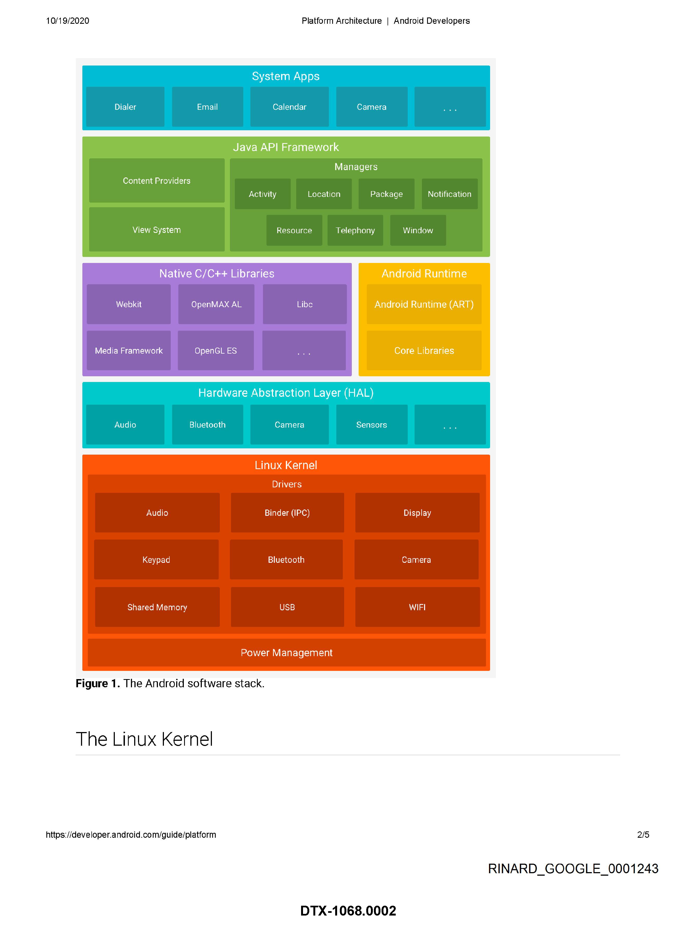
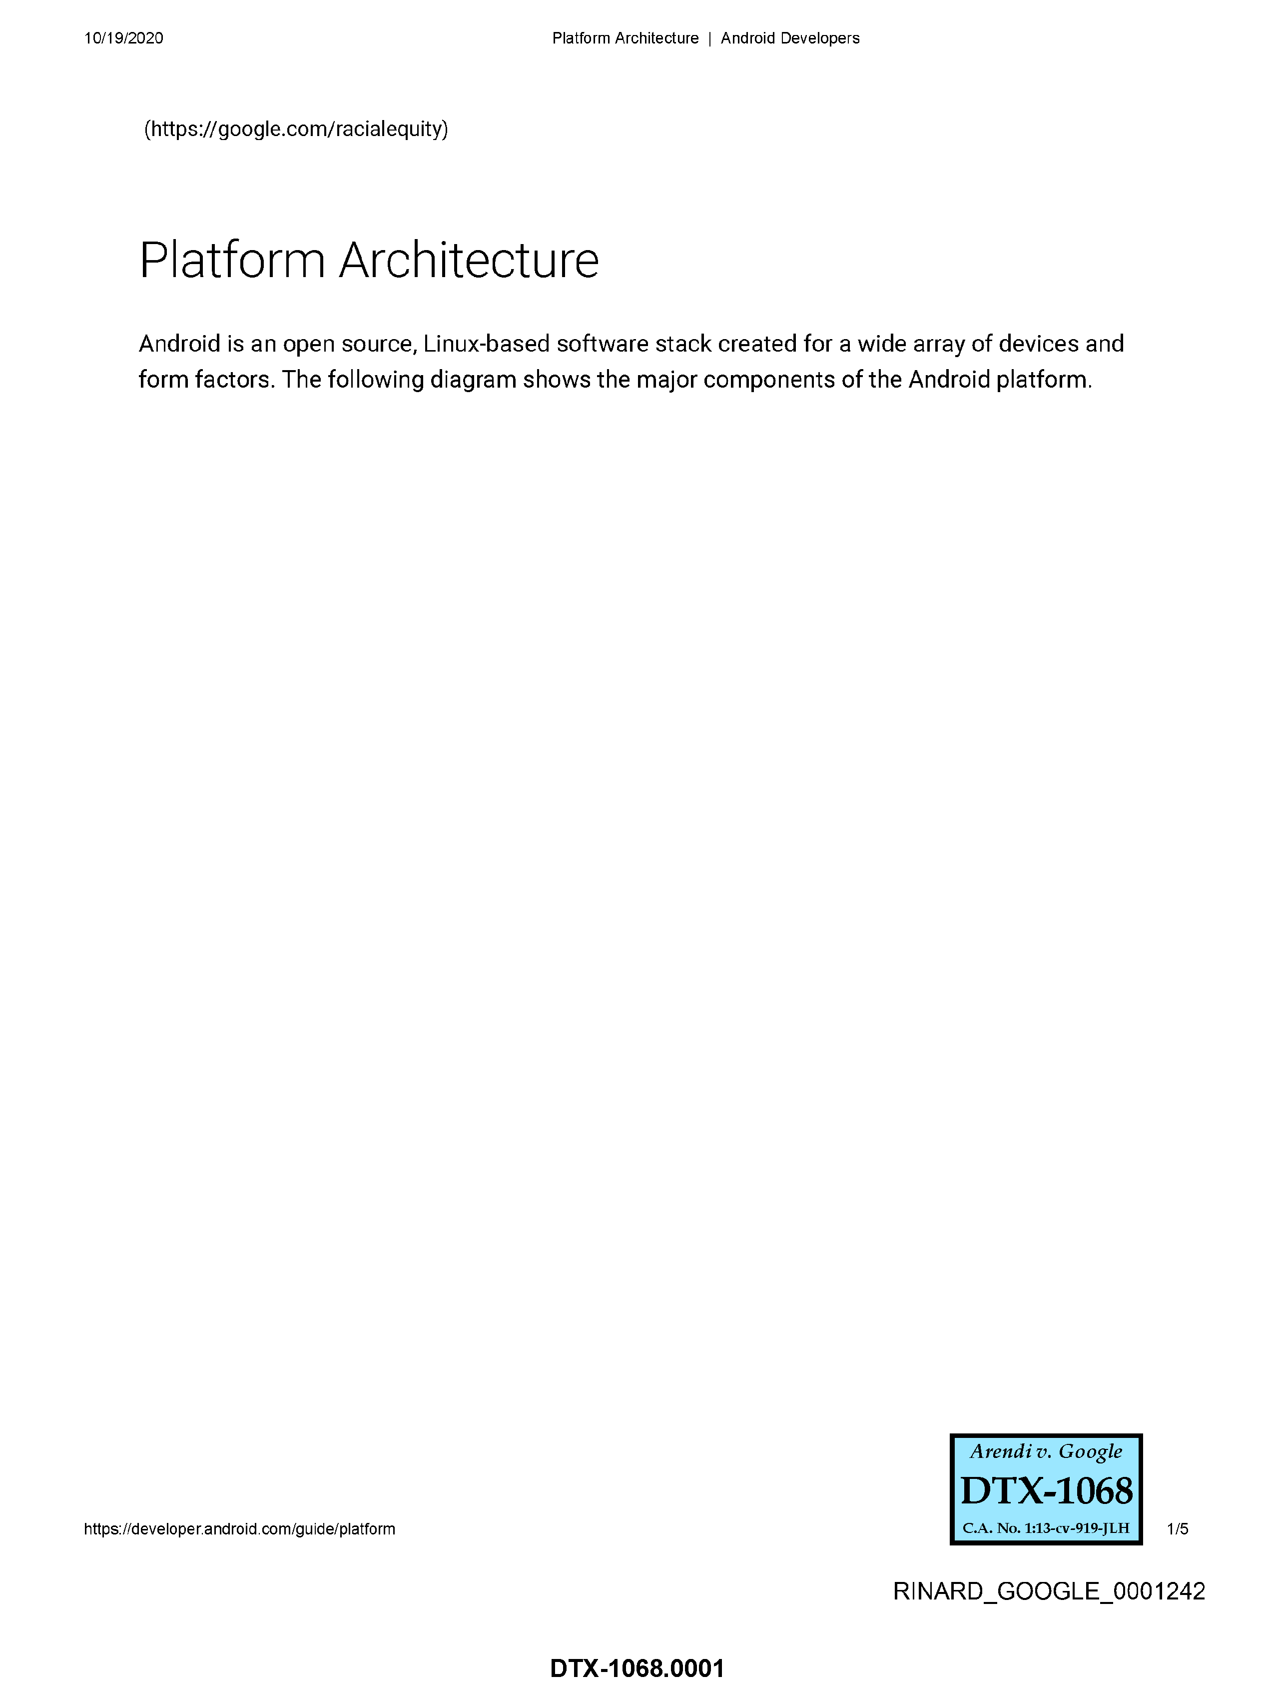
Android Architecture
DTX 1068
DTX 1068.0002, Platform Architecture, Android Developers

Slide 9
Android Apps Are Separate From the Framework
DTX 1068
STS
DTX 1068.0002, Platform Architecture, Android Developers

Slide 10
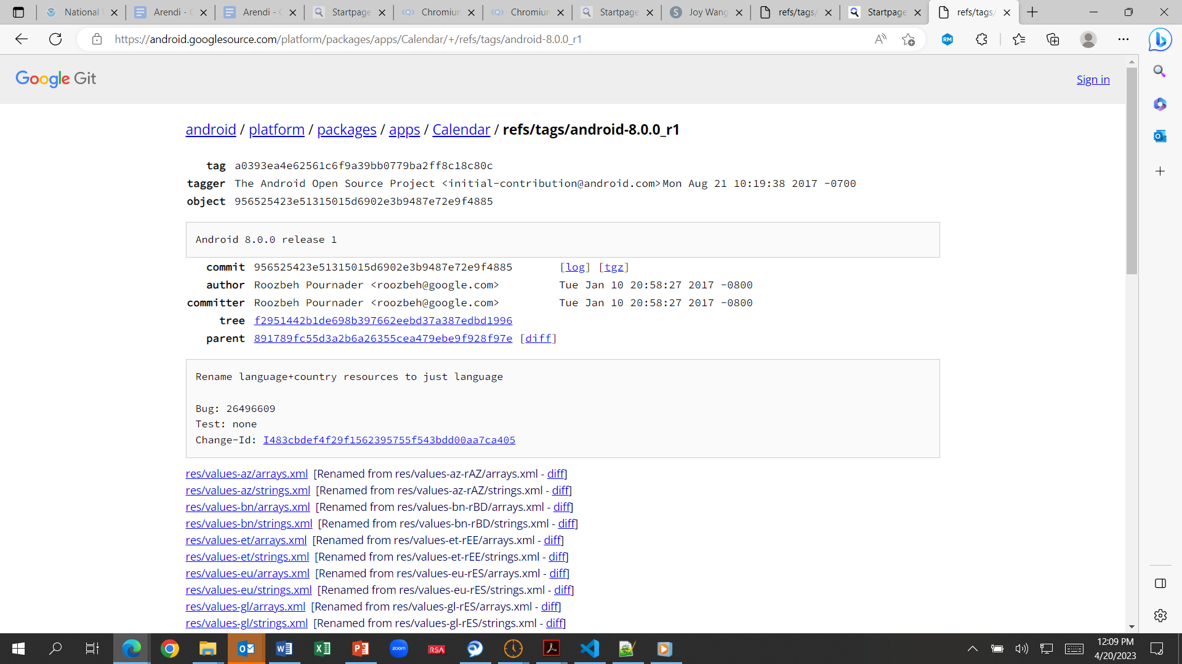
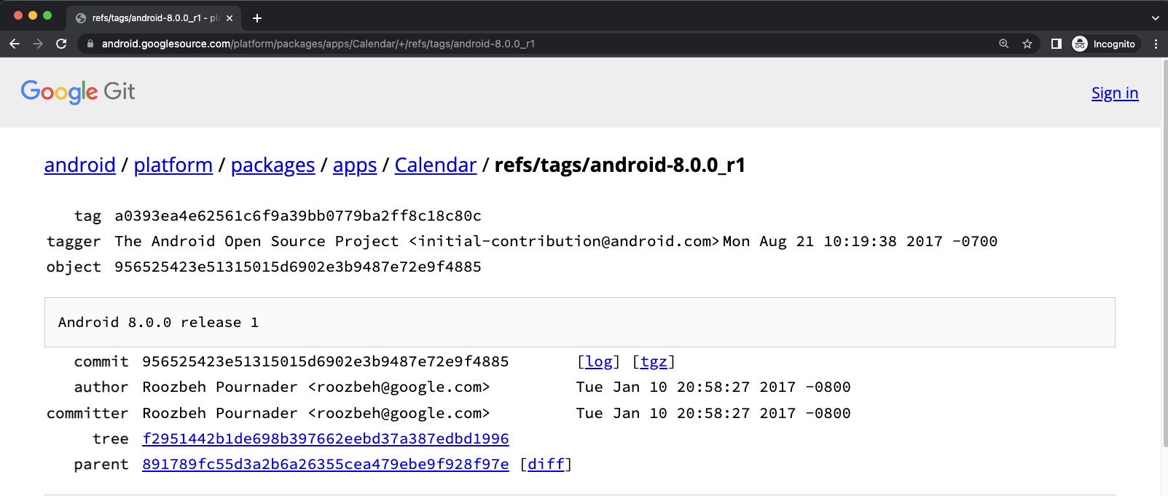
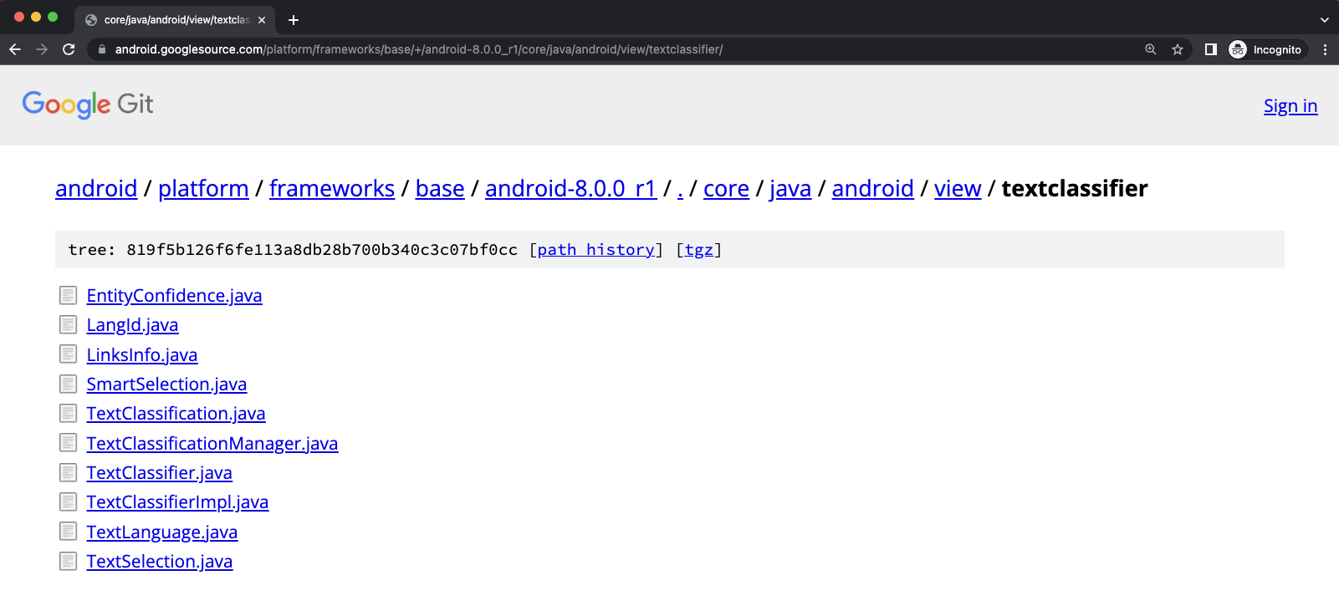
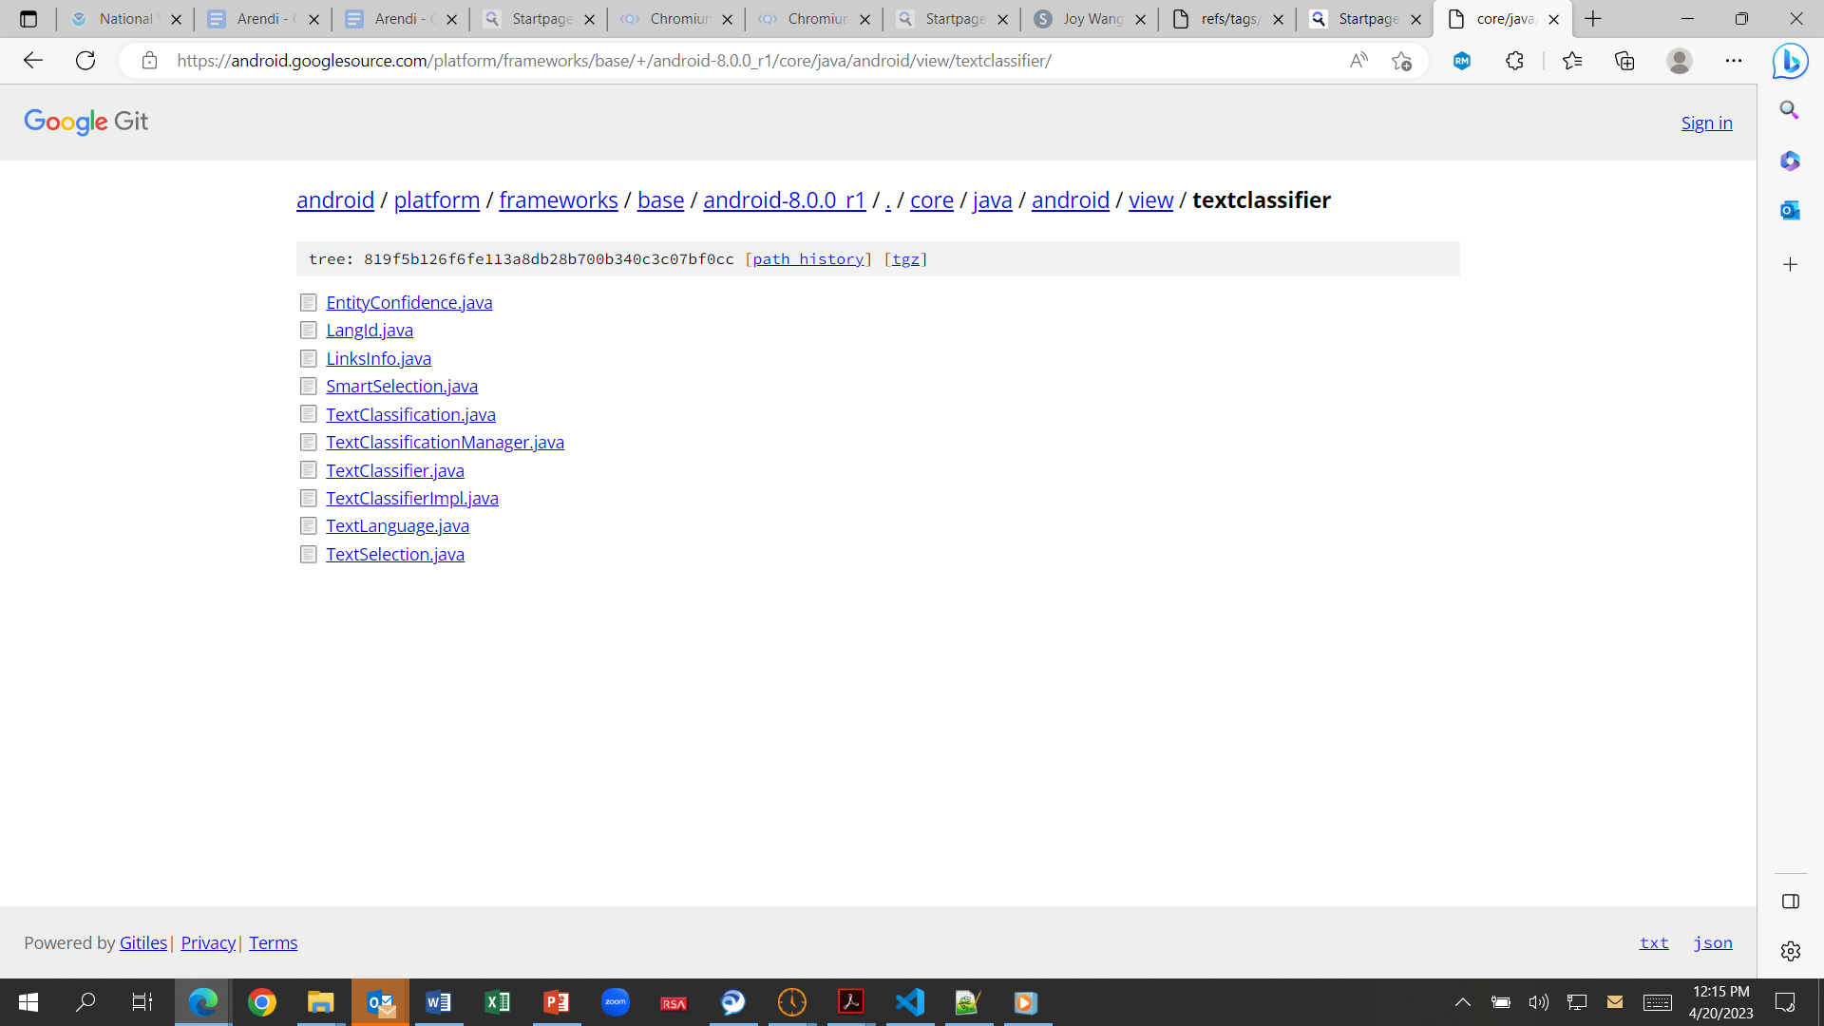
TextClassifier in the Framework
DTX 1068.0002
Notes:
https://android.googlesource.com/platform/packages/apps/Calendar/+/refs/tags/android-8.0.0_r1
https://android.googlesource.com/platform/frameworks/base/+/android-8.0.0_r1/core/java/android/view/textclassifier/

Slide 11
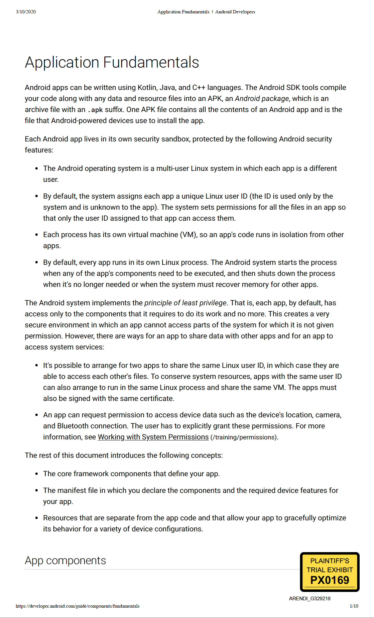
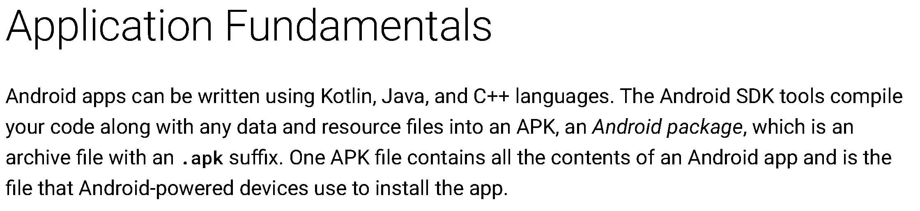
Application Packages (APKs) Contain All the Content of an Android App
Android Developer: Application Fundamentals
PX0169, Application Fundamentals - Android Developers

Slide 12
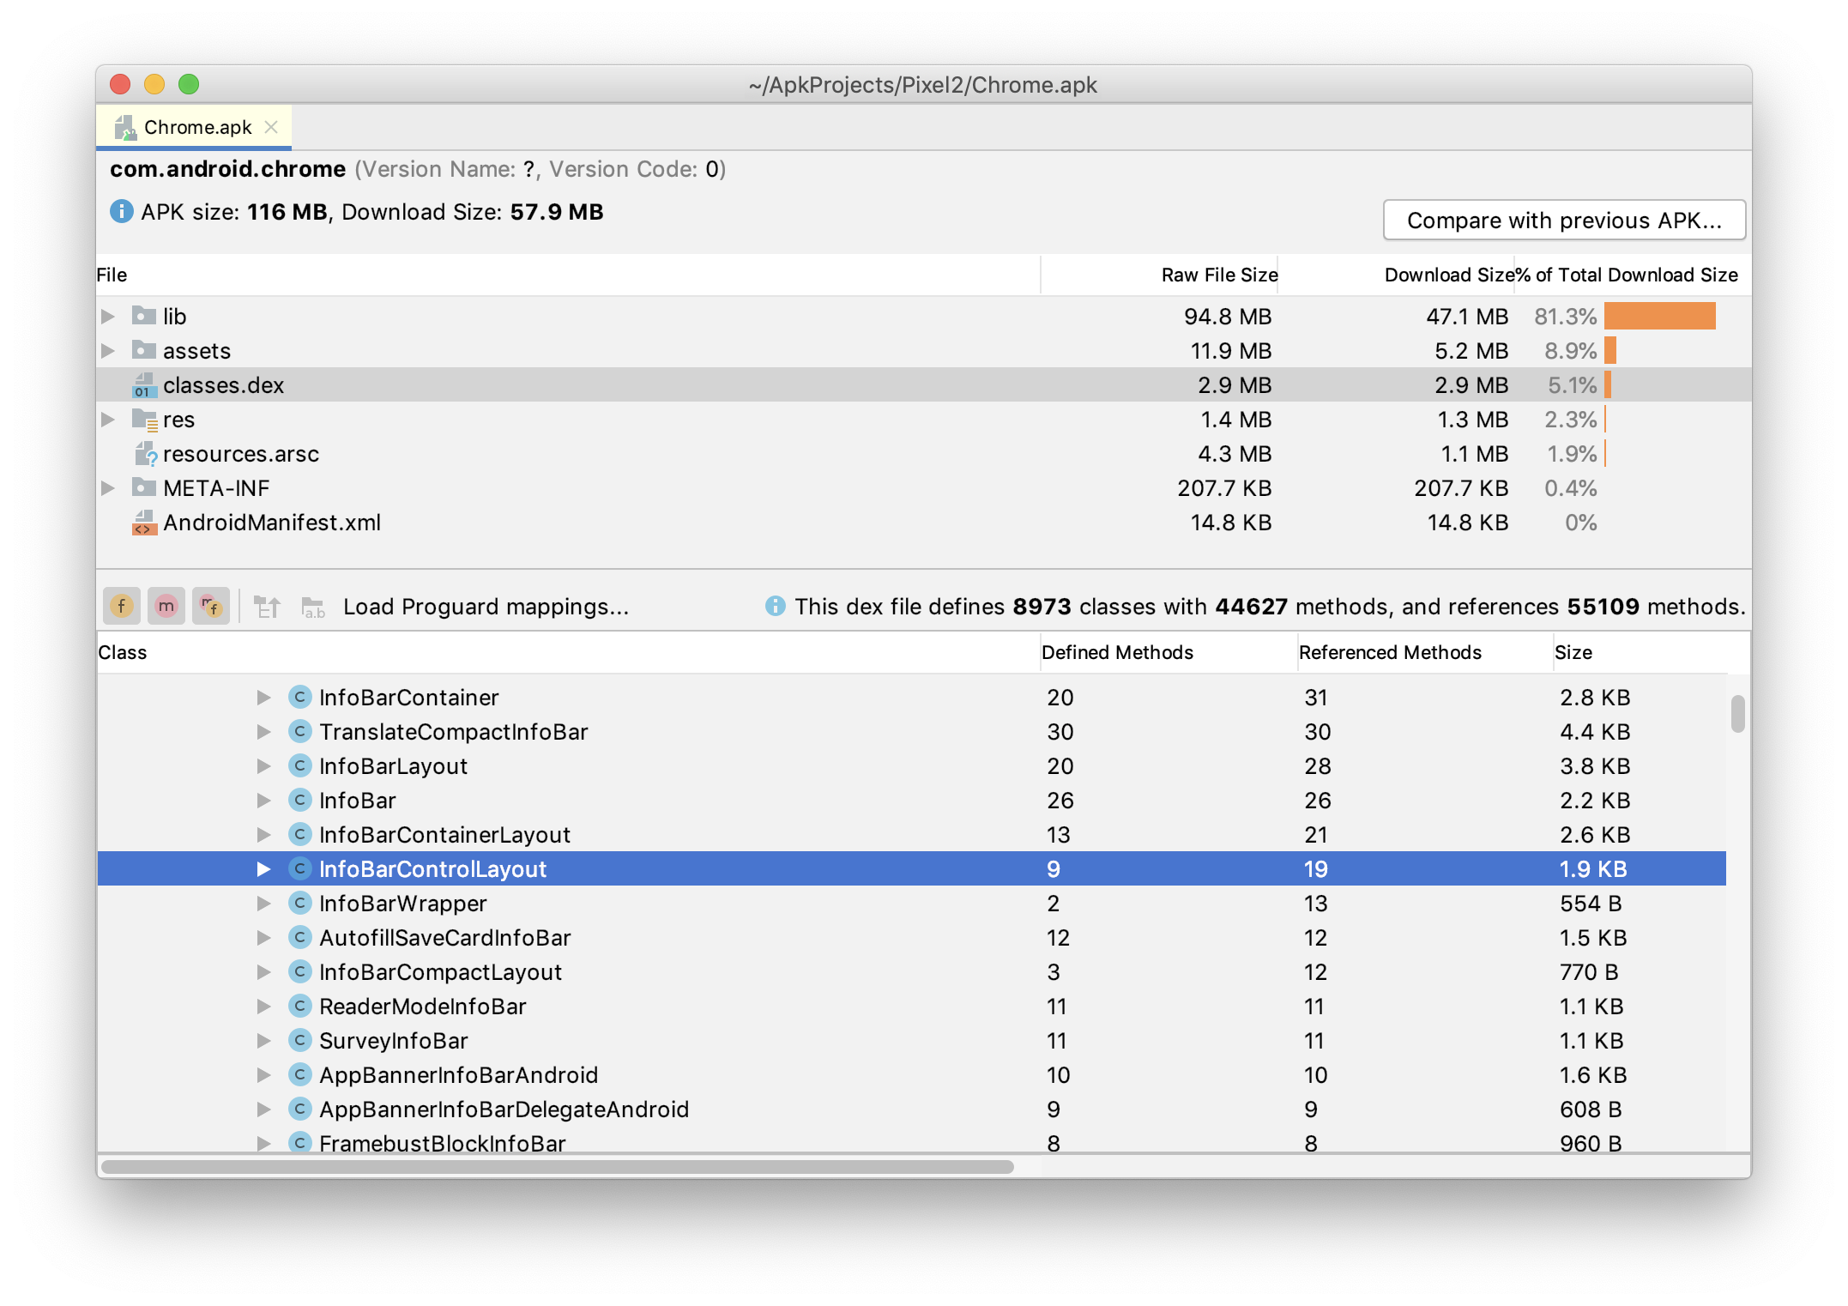
Application Packages Analysis

Slide 13
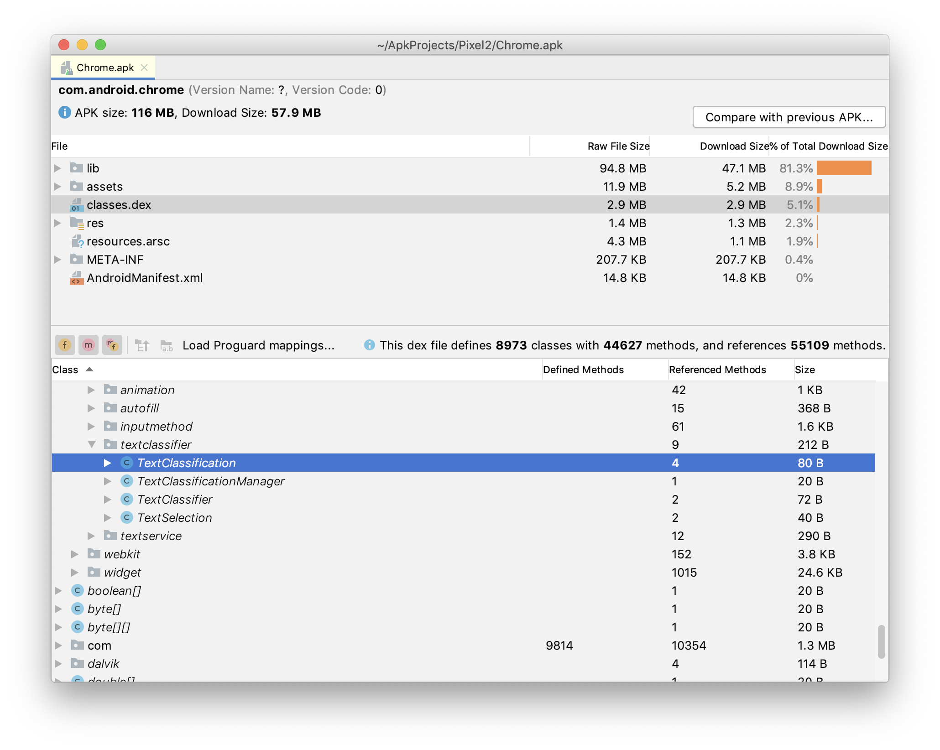
Application Packages Analysis

Slide 14
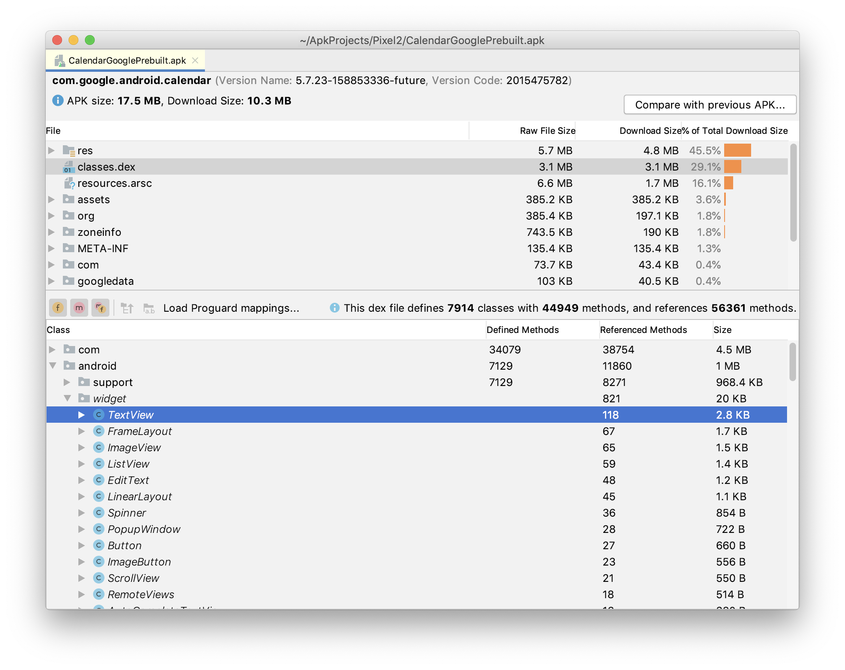
Application Packages Analysis

Slide 15












Application Packages Analysis Tool Used for All Apps
Chrome
Sheets
Contacts
Docs
Calendar
Keep
Messages/Messaging
Inbox
Tasks
Hangouts
Slides
Gmail

Slide 16
Applications Do Not Set Up the Input Device
Approach 1
Approach 2
App 1
Tool
STS
App 2
App
App 3

Slide 17
“Providing an input device, configured by the first computer program”
23. At least one non-transitory computer readable medium encoded with instructions which, when loaded on a computer, establish processes for finding data related to the contents of a document using a first computer program running on a computer, the processes comprising:
displaying the document electronically using the first computer program;
while the document is being displayed, analyzing, in a computer process, first information from the document to determine if the first information is at least one of a plurality of types of information that can be searched for in order to find second information related to the first information;
retrieving the first information;
providing an input device, configured by the first computer program, that allows a user to enter a user command to initiate an operation, the operation comprising (i) performing a search using at least part of the first information as a search term in order to find the second information, of a specific type or types, associated with the search term in an information source external to the document, wherein the specific type or types of second information is dependent at least in part on the type or types of the first information, and (ii) performing an action using at least part of the second information;
in consequence of receipt by the first computer program of the user command from the input device, causing a search for the search term in the information source, using a second computer program,
in order to find second information related to the search term; and
if searching finds any second information related to the search term, performing the action using at least part of the second information, wherein the action is of a type depending at least in part on the type or types of the first information.
1
Accused Products Infringe?
’843
NO
NO
PX0001, ’843 Patent, Claim 23
NO
NO
NO

Slide 18
Two Approaches for Shortcut Tools in the 1990s
Approach 1
Approach 2
App 1
Tool
Tool
App 2
App
CyberDesk
Apple Data Detectors
PatCo approach
(AESD)
App 3

Slide 19
Arendi’s Arguments for Infringement Contradict Its Arguments to the PTO
Here, PatCo accuses Google’s apps even though the instructions that set up the input device and receive the user command are SEPARATE from the apps.
If PatCo. is right, the patent covers CyberDesk and ADD.

Slide 20
Two Approaches for Shortcut Tools in the 1990s
Approach 1
Approach 2
App 1
Tool
Tool
App 2
App
PatCo.
approach
(Smedley)
PatCo. approach
(AESD)
App 3

Slide 21
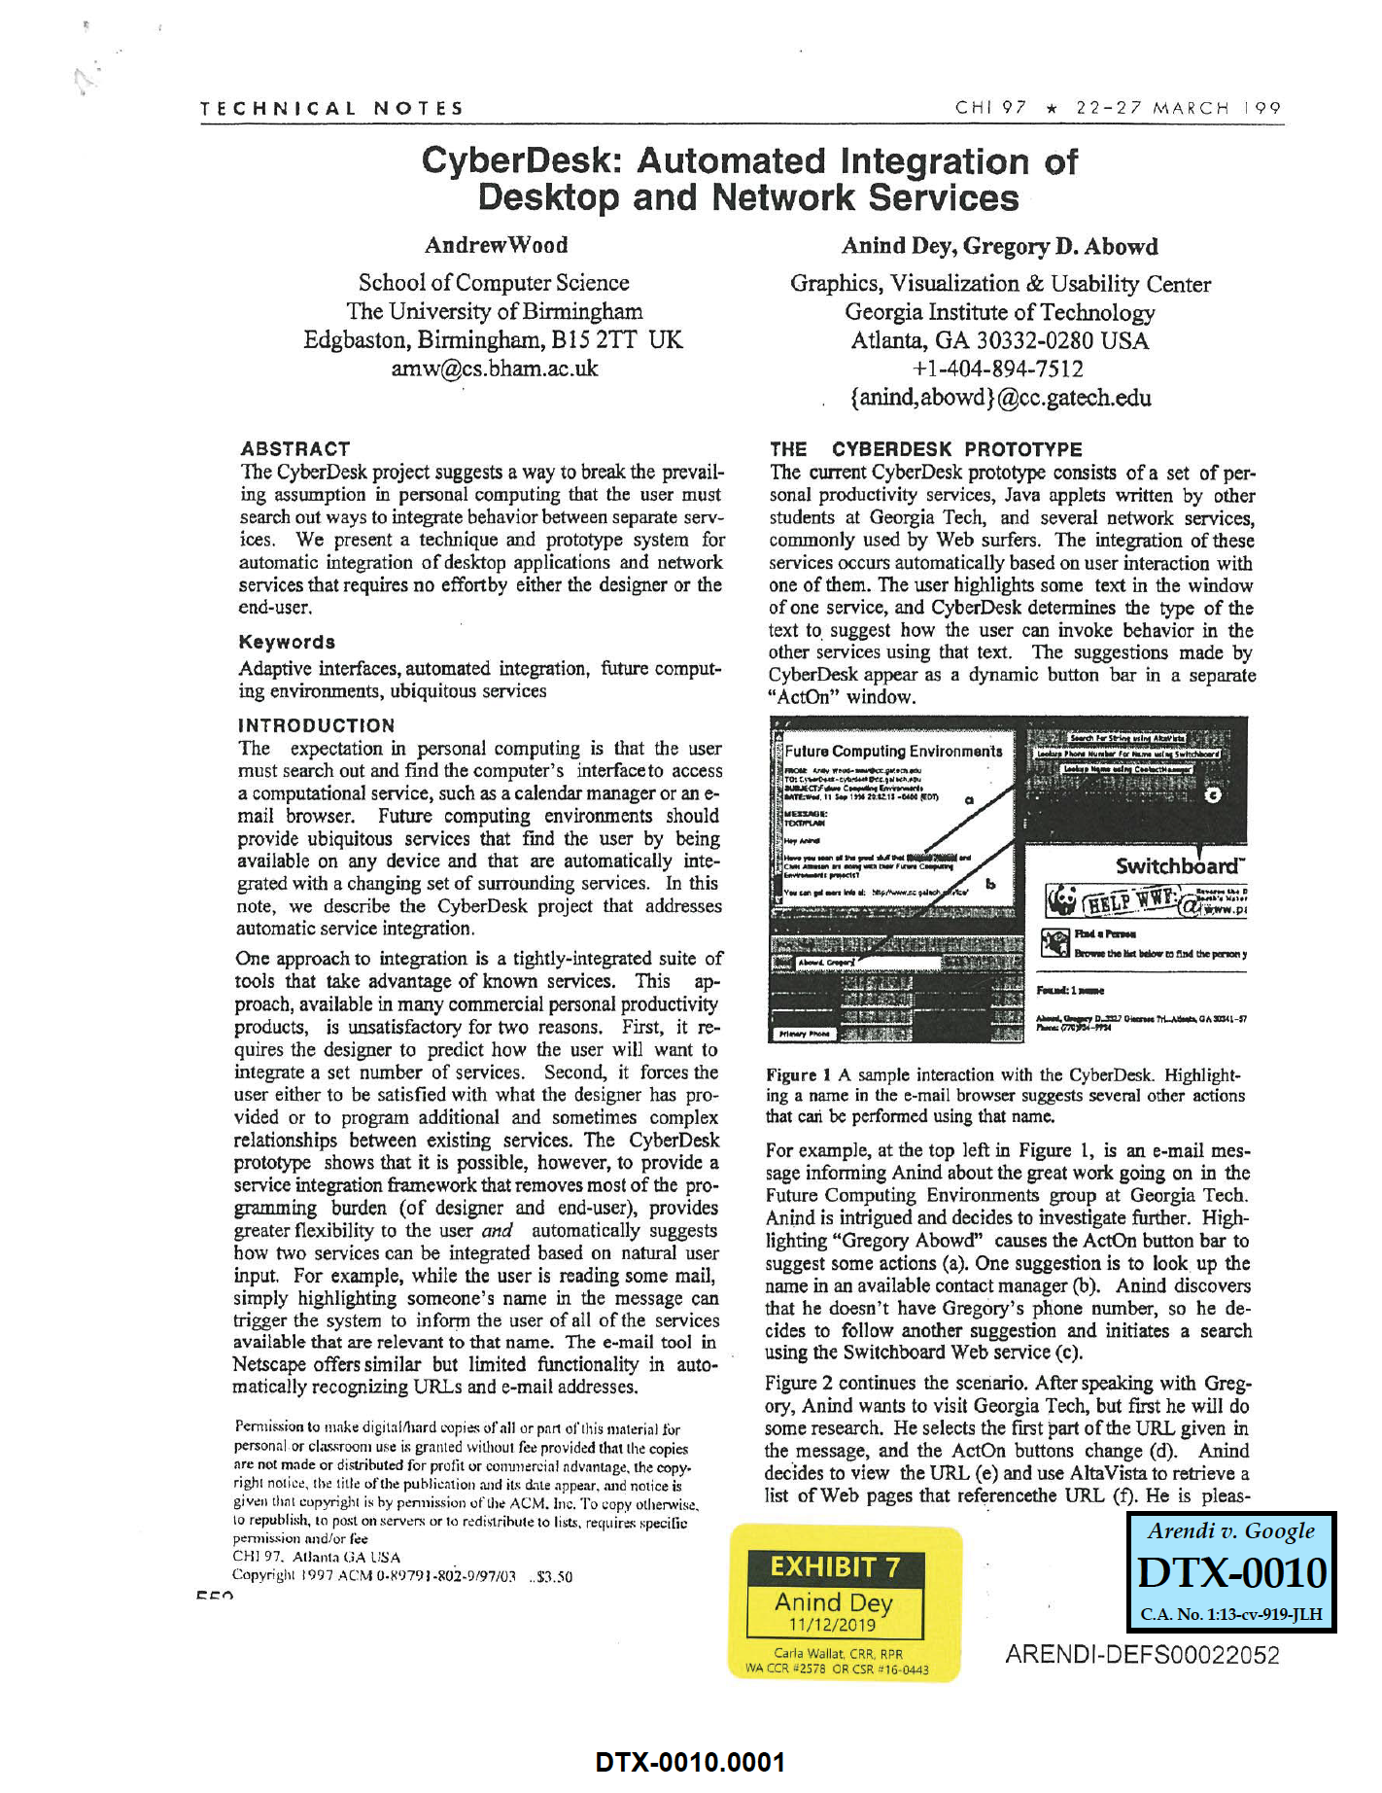
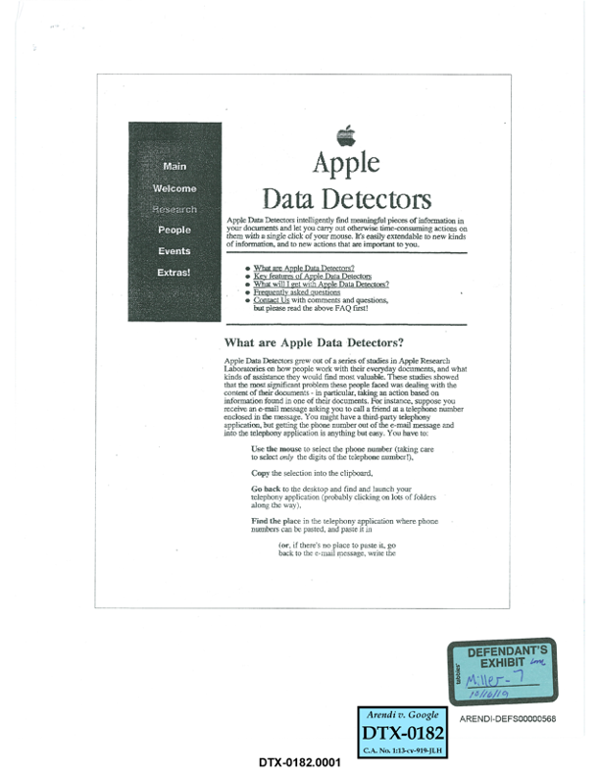

Summary of Opinions: The Asserted Claims of the ’843 Patent Are Invalid
Click icon to add picture
Anticipated by CyberDesk System
CyberDesk
and
Obvious in light of combinations of 3 prior art systems:
CyberDesk System
Apple Data Detectors System
Microsoft Word 97
Click icon to add picture
Click icon to add picture
CyberDesk
ADD

Slide 22
Summary of Opinions: The Asserted Claims of the ’843 Patent Are Invalid
Click icon to add picture
Anticipated by CyberDesk System
CyberDesk
and
Obvious in light of combinations of 3 prior art systems:
CyberDesk System
Apple Data Detectors System
Microsoft Word 97
Click icon to add picture
Click icon to add picture
CyberDesk
ADD

Slide 23

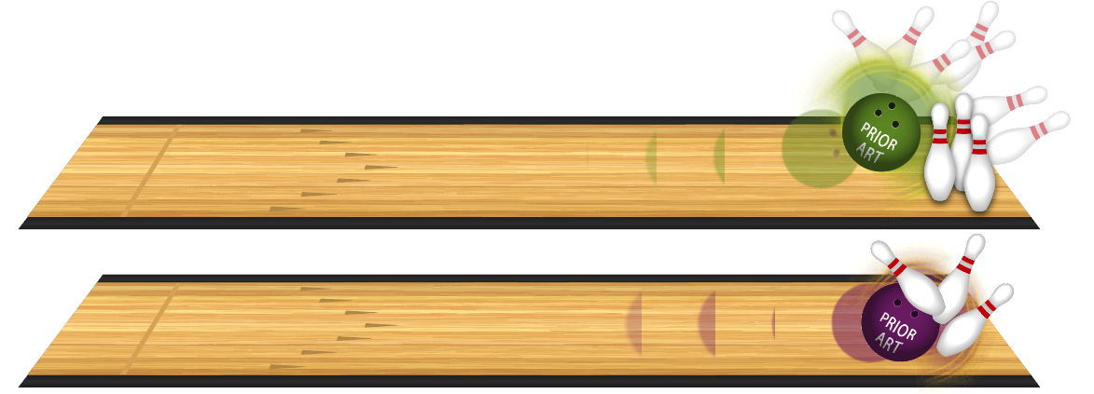
Invalidating a Patent by Anticipation or Obviousness
Anticipation:
One prior art reference, product, or system has all the elements
Obviousness:
One prior art reference, product, or system has many elements, and another has the rest

Slide 24
’526 Patent
get |
tcp |
connection|
CK6
CK7
CK8
command action value
command action value
command action value
Accused Product
get
tcp
connection
Action
command action value

Slide 25







What is an Industry Standard?

Slide 26
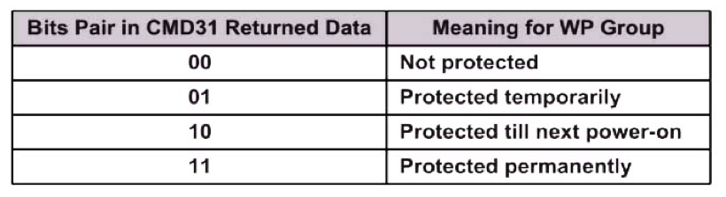
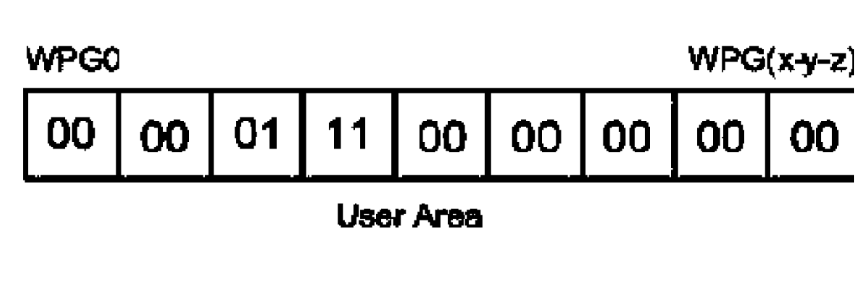
AcmeCo’s Products Use the Same Address for Temporary and Permanent Write Protection
File ID 31
DTX 0118 at SAN00202981

Slide 27
AcmeCo’s Products Use the Same Address for Temporary and Permanent Write Protection
File ID 31
DTX 0118 at SAN00202981

Slide 28
AcmeCo’s Products Use the Same Address for Temporary and Permanent Write Protection
temporary write protection
permanent write protection
File ID 31
DTX 0118 at SAN00202981

Slide 29


Hardware
RTL description
fabrication
(in Asia)
synthesis
place & route
HDL:
hardware description language
specification and design
netlist
Layout
GDS file
bus (to device)
firmware
flash memory
hardware chip

Slide 30
Hardware
RTL description
fabrication
(in Asia)
synthesis
place & route
HDL:
hardware description language
specification and design
netlist
Layout
GDS file
iNAND / SD / microSD
bus (to device)
firmware
flash memory
hardware chip

Slide 31
High Level Architecture of AcmeCo’s
Twin-Core Processor Products
Display
Twin-Core Processor
Qualcomm PMIC
Main Battery
DDR RAM
Applications
Processor
Flash Memory
Modem
Processor
Antenna
Speaker
RF Circuitry
Microphone
Notes:
Figure 1

Slide 32
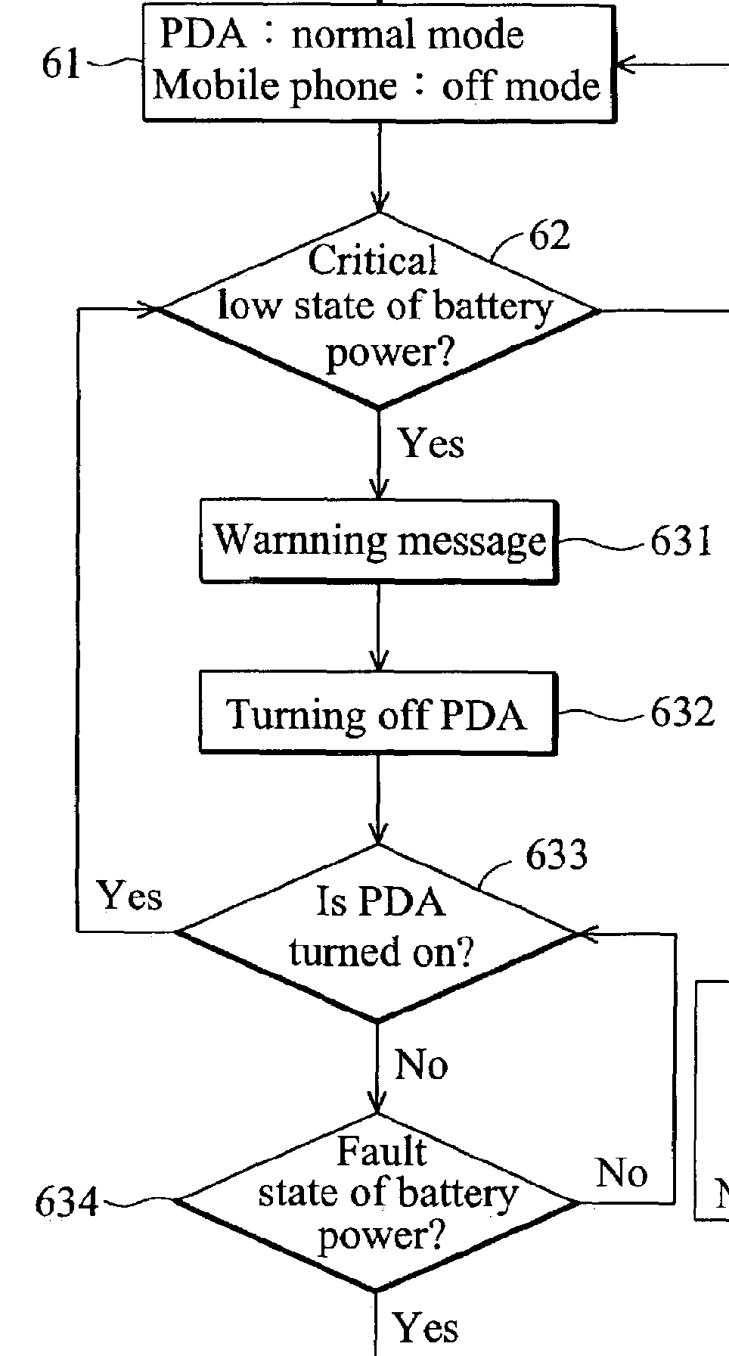


PatCo’s Battery Trap Routine Mirrors
’800 Preferred Embodiment
’800 Patent, 4:50-51

Slide 33
AcmeCo’s Two Separately Set Thresholds
(High Level)
system shut down state
power key
RTC alarm
USB/AC
adapter
hardware
power-on state
BL
battery power
< 1st
threshold
Yes
Time
No
Modem Processor
software
OS
battery power
< 2nd
threshold
Yes
Applications Processor

Slide 34



PatCo. Provides a
“Manually Operable Scanning Device”
Thomas
Tim
Trixie
U
Uncle Mark
Uncle Mike
V
Van
Victor
Vivian
W
Walty
Willa
Y
Yoshi
#
(555) 555-1234
(415) 555-2345
(555) 123-3456
(212) 234-4567
(202) 345-5678
(239) 456-6789
(716) 223-1208
AT&T
10:57 AM
+
All Contacts
Groups
ABCDEFGHIJKLMNOPQRTSUVWXYZ#

